Slide 1

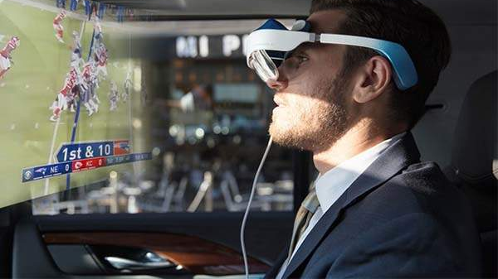


Using Augmented Reality to improve the lives of elderly people
By
Johan Jose
This Photo by Unknown Author is licensed under CC BY-SA-NC

Slide 2

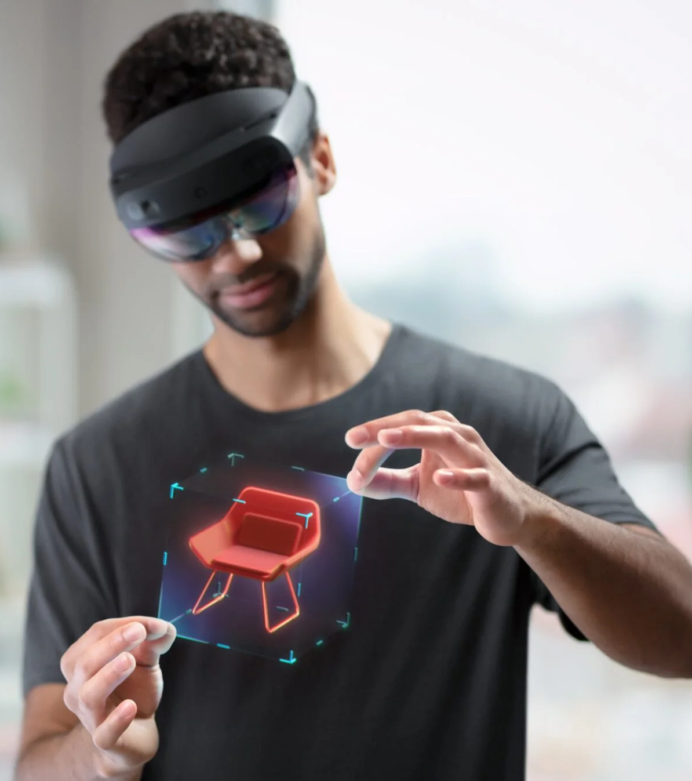
What is Augmented Reality?
Augmented Reality is an interactive experience of a real-world environment where the objects that reside in the real world are enhanced by computer-generated perceptual information.

Slide 3
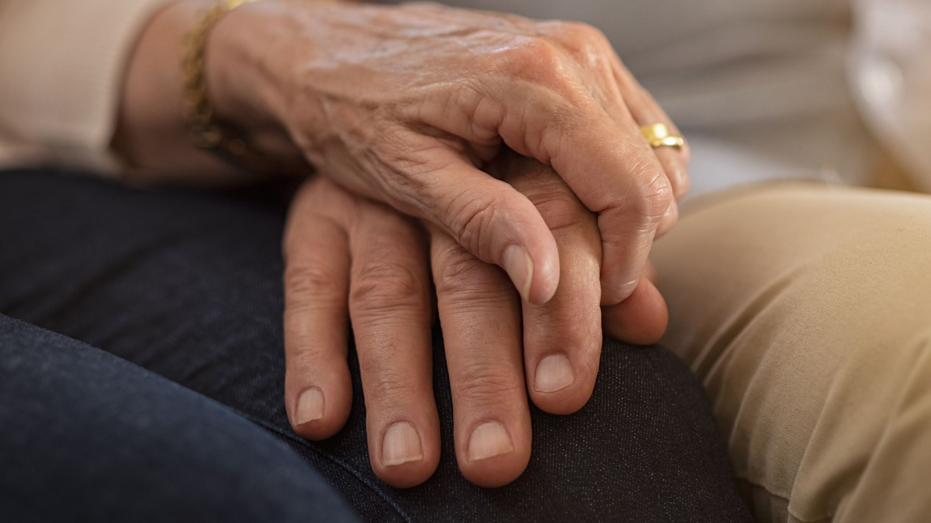

What are Problems faced by elderly people?
Memory Loss
Financial Insecurity
Difficulty in everyday tasks
Loneliness
Health issues

Slide 4
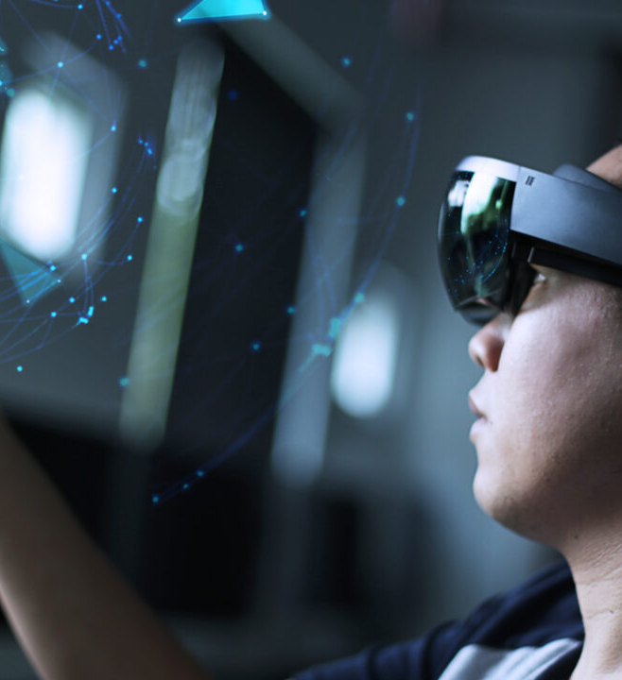
How the lives of elderly people can be improved by augmented reality?
The use of augmented reality (AR) promises many benefits for older adults, such as promoting a healthy lifestyle with health-related gaming, maintaining social contact via digital interfaces, supporting rehabilitation, and aiding in everyday life tasks.
AR may assist those individuals with mild memory issues or cognitive declines in navigating unfamiliar areas by presenting them with information about a city or building directly on their smartphones.
AR can support new forms of social interaction, such as those with avatars or embodied agents. older adults can have valuable social interactions when they play AR-based games together with other individuals.
The use of AR in health promotion, such as psychotherapy and rehabilitation, can help to maintain health and well-being in older adults. The tools can contribute to maintaining older adults’ motor abilities, fitness, cognition, balance, and memory.

Slide 5
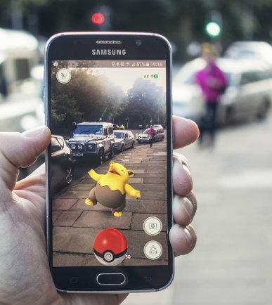
Thank you for listening!

